Slide 1
Last week: Correlation coefficient
Pearson correlation coefficient, R
cor(x, y, method = "pearson")
cor.test(x, y, method = "pearson")
Coefficient of determination, R²
cor.test(x, y, method = "pearson")$estimate ^ 2
Spearman’s correlation coefficient, ρ
cor(x, y, method = "pearson")
cor.test(x, y, method = "pearson")
This week: Linear regression
Linear regression
lm(y ~ x, data = data)
summary(model)
anova(model)
Testing assumptions
Residual plot – residuals of model vs X
mean(residuals) = 0
plot(model)
Calculating model
Plotting results

Slide 2
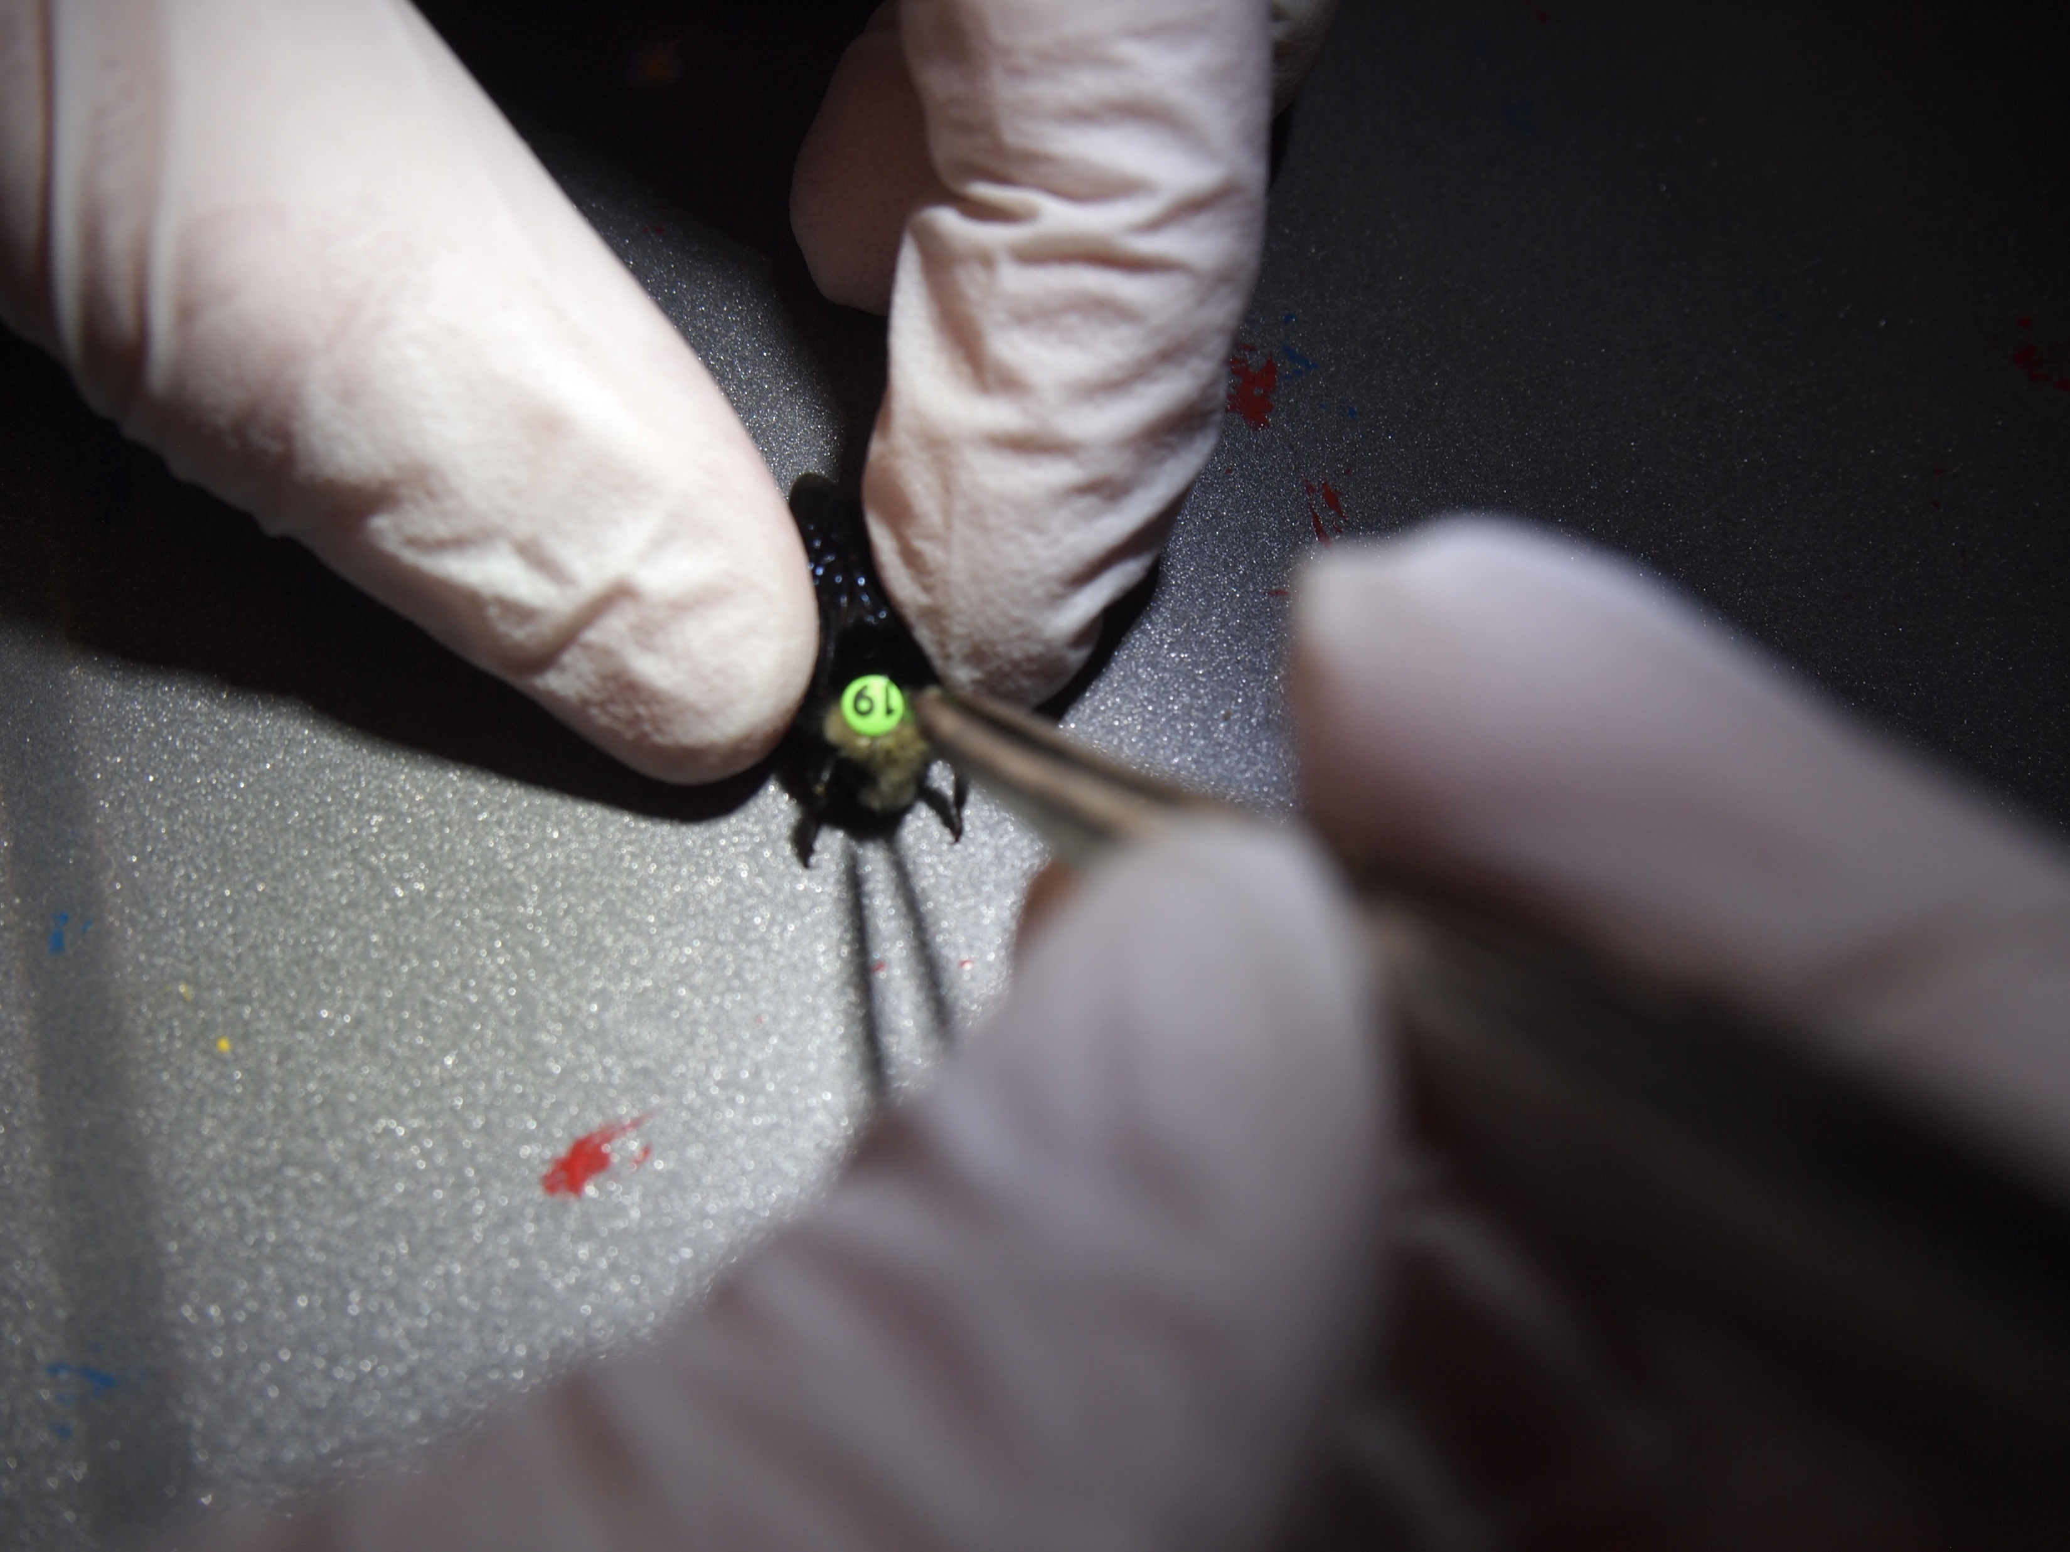
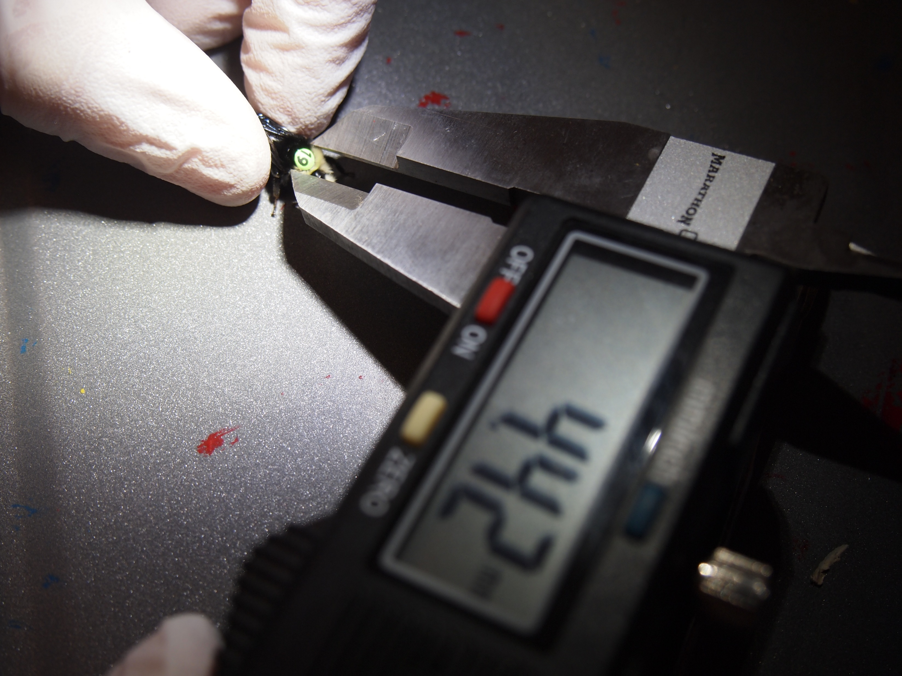
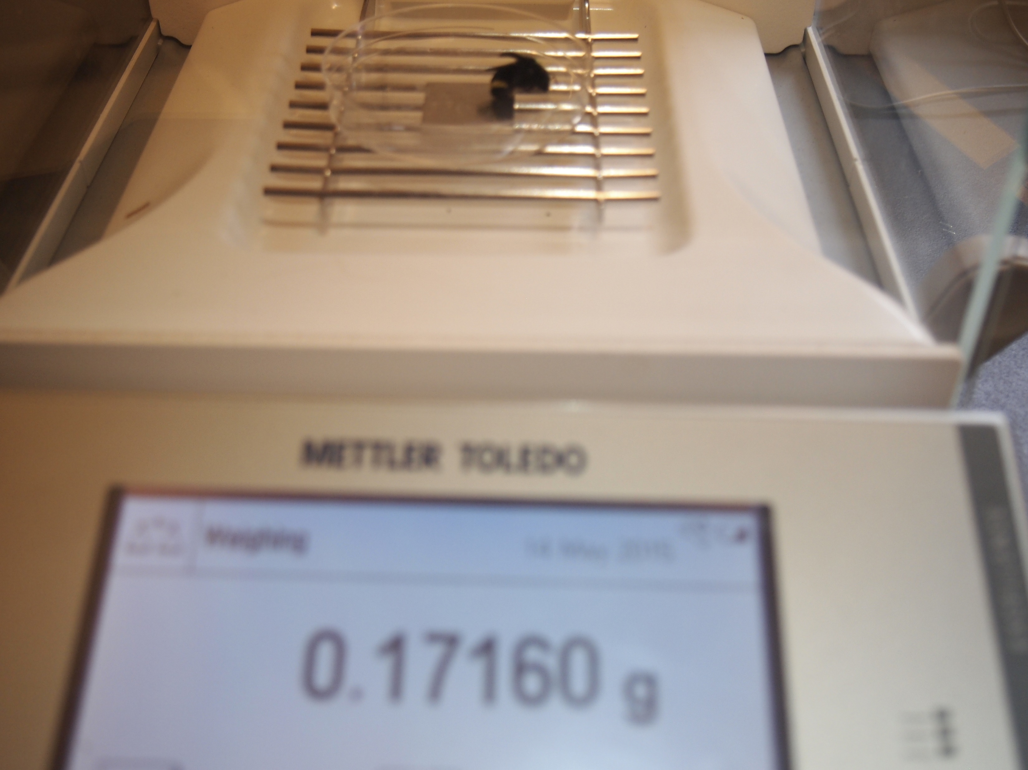
Exercise 1: Does body size affect nectar returns?
Data: Bees were captured at night time to uniquely tag individual workers and measure their body size, intertegular span (mm) and body weight (g). During the day, tagged bees were captured upon returning to the colony. Pollen was collected and bees were weighed. Nectar weights (g) were calculated by the change in weight from day to night time.
Instructions:
1. Run a linear regression to investigate whether body size affects the nectar returns of worker bumble bees.
2. Create a residual plot.
3. Test other assumptions.
4. Assess model fit, and write out equation using coefficients.
5. Write summary statement.

